Slide 1
Kingdom Parables
Doug Withers
13 March 2016

Slide 2
Why did Jesus speak in parables?

Slide 3
Why did Jesus speak in parables?
Then the disciples came and asked Jesus, “Why do you speak to people in parables?”
He answered them, “You have been given knowledge about the secrets of the kingdom from heaven, but it hasn’t been given to them, because to anyone who has something, more will be given, and he will have more than enough. But from the one who doesn’t have anything, even what he has will be taken away from him.” Matt 13:10-12 ISV

Slide 4
Why did Jesus speak in parables?
“That’s why I speak to them in parables, because ‘they look but don’t see, and they listen but don’t hear or understand.’ “With them the prophecy of Isaiah is being fulfilled, which says: ‘You will listen and listen but never understand. You will look and look but never comprehend for this people’s heart has become dull, and their ears are hard of hearing. They have shut their eyes so that they might not see with their eyes, and hear with their ears, and understand with their heart and turn, and I would heal them.’
“How blessed are your eyes because they see, and your ears because they hear! I tell all of you with certainty, many prophets and righteous people longed to see the things you see but did not see them, and to hear the things you hear but did not hear them.” Matt 13:13-17 ISV

Slide 5
Why did Jesus speak in parables?
Jesus told the crowds all these things in parables. He did not tell them anything without using a parable. This was to fulfil what was declared by the prophet when he said,
“I will open my mouth to speak in parables. I will declare what has been hidden since the creation of the world.” Matt 13:34-35 ISV

Slide 6
Why did Jesus speak in parables?
… this secret was made known to me through a revelation, just as I wrote about briefly in the past. By reading this, you will be able to grasp my understanding of the secret about the Messiah, which in previous generations was not made known to human beings as it has now been revealed by the Spirit to God’s holy apostles and prophets.
This is that secret: The gentiles are heirs-in-common, members-in-common of the body, and common participants in what was promised by the Messiah Jesus through the gospel. Eph 3:3-6 ISV

Slide 7
Layout of verses in Matthew 13
Verses: 3-9 1: Sower and the four Soils
10-17 Why Parables?
18-23 Sower & 4 Soils Explained
24-30 2: Tares & Wheat
31-32 3: Mustard Seed
33 4: Woman & Leaven
34-35 Why Parables? (continued)
36-43 Tares & Wheat Explained
44 5: Treasure in the Field
45-46 6: Pearl of Great Price
47-48 7: Dragnet
49-50 Drag Net Explained

Slide 8
5 other Kingdom Parables
8: Forgiveness of Debts Matt 18:23-35
9: Latecomers equally paid Matt 20:1-16
10: Guests at Marriage Feast Matt 22:1-14
11: Ten Virgins Matt 25:1-13
12: Stewardship of Talents Matt 25:14-30

Slide 9
The Kingdom of Heaven in 12s
12 Kingdom Parables;
12 Kingdom Mysteries;
12 Apostles will rule over the 12 Tribes. (Mt 19:28; Lk 22:30);
12,000 sealed from each of the 12 Tribes. (Rev 7);
The New Jerusalem has:
– 12 gates
– 12 foundation stones
– 12,000 x 12,000 x 12,000 furlongs in size. (Rev 21).
12 seems to be a number associated with the Kingdom.

Slide 10
Decoding a message

Slide 11
Decoding a message

Slide 12
Decoding a message

Slide 13
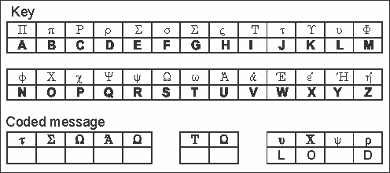
Decoding a message

Slide 14
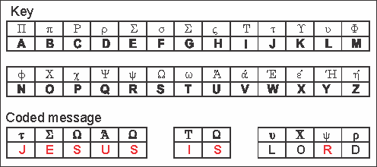
Decoding a message

Slide 15
The Four Soils
Then he began to tell them many things in parables. He said,
“Listen! A farmer went out to sow. As he was sowing, some seeds fell along the path, and birds came and ate them up.
Other seeds fell on stony ground, where they did not have a lot of soil. They sprouted at once because the soil wasn’t deep. But when the sun came up, they were scorched. Since they did not have any roots, they dried up.
Other seeds fell among thorn bushes, and the thorn bushes grew higher and choked them out.
But other seeds fell on good soil and produced a crop, some 100, some 60, and some 30 times what was sown. Let the person who has ears listen!” Matt 13:3-9 ISV

Slide 16
Four Soils: Explained
“Listen, then, to the parable about the farmer.
When anyone hears the word about the kingdom yet doesn’t understand it, the evil one comes and snatches away what was sown in his heart. This is what was sown along the path.
As for what was sown on the stony ground, this is the person who hears the word and accepts it joyfully at once, but since he doesn’t have any root in himself, he lasts for only a short time. When trouble or persecution comes along because of the word, he immediately falls away.
As for what was sown among the thorn bushes, this is the person who hears the word, but the worries of life and the deceitful pleasures of wealth choke the word so that it can’t produce a crop.
But as for what was sown on good soil, this is the person who hears the word, understands it, and produces a crop that yields 100, 60, or 30 times what was sown.” Matt 13:18-23 ISV

Slide 17
Four Soils: Explained
“Listen, then, to the parable about the farmer.
When anyone hears the word about the kingdom yet doesn’t understand it, the evil one comes and snatches away what was sown in his heart. This is what was sown along the path.
As for what was sown on the stony ground, this is the person who hears the word and accepts it joyfully at once, but since he doesn’t have any root in himself, he lasts for only a short time. When trouble or persecution comes along because of the word, he immediately falls away.
As for what was sown among the thorn bushes, this is the person who hears the word, but the worries of life and the deceitful pleasures of wealth choke the word so that it can’t produce a crop.
But as for what was sown on good soil, this is the person who hears the word, understands it, and produces a crop that yields 100, 60, or 30 times what was sown.” Matt 13:18-23 ISV

Slide 18
Tares & Wheat
He presented another parable to them:
“The kingdom from heaven may be compared to a man who sowed good seed in his field. While people were sleeping, his enemy came and sowed weeds among the wheat and went away. When the crop came up and bore grain, the weeds appeared, too.
“The owner’s servants came and asked him, ‘Master, you sowed good seed in your field, didn’t you? Then where did these weeds come from?’ “He told them, ‘An enemy did this!’ “The servants asked him, ‘Do you want us to go and pull them out?’
“He said, ‘No! If you pull out the weeds, you might pull out the wheat with them. Let both grow together until the harvest, and at harvest time I will tell the reapers, “Gather the weeds first and tie them in bundles for burning, but bring the wheat into my barn.”’”
Matt 13:24-30 ISV

Slide 19
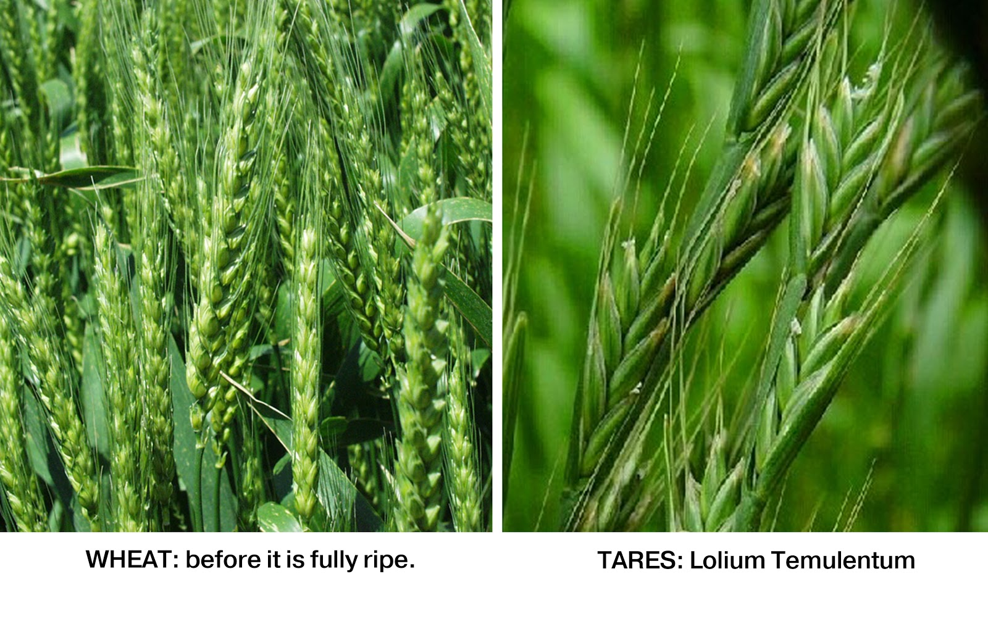

Slide 20
Tares & Wheat: Explained
Then Jesus left the crowds and went into the house. His disciples came to him and asked, “Explain to us the parable about the weeds in the field.” He answered,
“The person who sowed good seed is the Son of Man, while the field is the world. The good seed are those who belong to the kingdom, while the weeds are those who belong to the evil one. The enemy who sowed them is the Devil, the harvest is the end of the age, and the reapers are the angels.
Just as weeds are gathered and burned with fire, so it will be at end of the age. The Son of Man will send his angels, and they will gather from his kingdom everything that causes others to sin and those who practice lawlessness and they will throw them into a blazing furnace. In that place there will be wailing and gnashing of teeth. Then the righteous will shine like the sun in their Father’s kingdom. Let the person who has ears listen!” Matt 13:36-43 ISV

Slide 21
Jesus consistent use of idioms
The sower = Jesus;
The field = The people of the world.
Birds = Satan’s workers
Reapers = Angels
There is also the consistent theme of a battle between good and evil fighting over the hearts of mankind.

Slide 22
Mustard Seed
He presented another parable to them, saying,
“The kingdom from heaven is like a mustard seed that a man took and planted in his field. Although it is the smallest of all seeds, when it is fully grown it is larger than the garden plants and becomes a tree, and the birds in the sky come and nest in its branches.” Matt 13:31-33 ISV

Slide 23
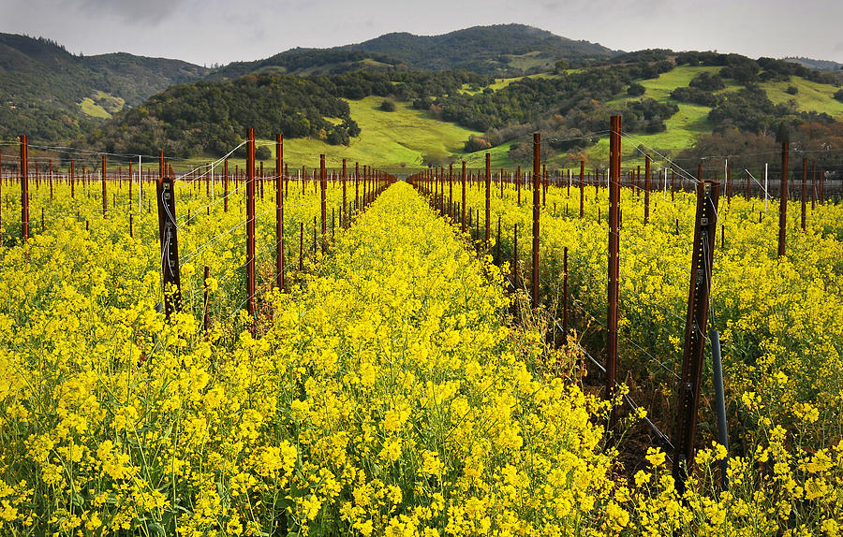
Mustard plants

Slide 24
‘birds’ in the branches of the Church
Judas among the disciples;
Ananias and Sapphira in the Jerusalem church (Acts 5:1-11);
Simon Magus in the church in Samaria (Acts 8:1-24);
Pauls letters to churches include a lot of teaching to correct the influences of false teachers.
For such people are false apostles, deceitful workers, masquerading as apostles of Christ. And no wonder, for Satan himself masquerades as an angel of light. It is not surprising, then, if his servants also masquerade as servants of righteousness. Their end will be what their actions deserve. 2Co 11:13-15 NIV

Slide 25
Woman & Leaven
He told them another parable.
"The kingdom of heaven is like leaven that a woman took and hid in three measures of flour, till it was all leavened."
Matthew 13:33 ESV

Slide 26
Woman & Leaven
He told them another parable.
"The kingdom of heaven is like leaven that a woman took and hid in three measures of flour, till it was all leavened."
Matthew 13:33 ESV
‘Three measures of flour’ is the fellowship offering which has no leaven.

Slide 27
Woman & Leaven
He told them another parable.
"The kingdom of heaven is like leaven that a woman took and hid in three measures of flour, till it was all leavened."
Matthew 13:33 ESV
‘Three measures of flour’ is the fellowship offering which has no leaven.
What this woman has done is a wicked and deceitful thing.

Slide 28
Treasure in the Field
“The kingdom from heaven is like treasure hidden in a field that a man found and hid. In his excitement he went and sold everything he had and bought that field.”
Matthew 13:44 ISV

Slide 29
Treasure in the Field
“The kingdom from heaven is like treasure hidden in a field that a man found and hid. In his excitement he went and sold everything he had and bought that field.”
Matthew 13:44 ISV
We don’t sell everything and ‘buy Jesus’!

Slide 30
We are God’s ‘Special Treasure’
Now therefore, if you will indeed obey My voice and keep My covenant, then you shall be a special treasure to Me above all people; for all the earth is Mine.
Ex 19:5 NKJV
For the LORD has chosen Jacob for Himself, Israel for His special treasure.
Psalm 135:4 NKJV

Slide 31
The Pearl of Great Price
“Again, the kingdom from heaven is like a merchant searching for fine pearls. When he found a very valuable pearl, he went and sold everything he had and bought it.”
Matthew 13:45, 46 ISV

Slide 32
The Pearl of Great Price
“Again, the kingdom from heaven is like a merchant searching for fine pearls. When he found a very valuable pearl, he went and sold everything he had and bought it.”
Matthew 13:45, 46 ISV
Oysters are not kosher so this has a gentile flavour to it.

Slide 33
The Pearl of Great Price
“Again, the kingdom from heaven is like a merchant searching for fine pearls. When he found a very valuable pearl, he went and sold everything he had and bought it.”
Matthew 13:45, 46 ISV
Oysters are not kosher so this has a gentile flavour to it.
The pearl is removed from where it was grown to become an item of adornment.

Slide 34
The Drag Net
“Again, the kingdom from heaven is like a large net thrown into the sea that gathered all kinds of fish. When it was full, the fishermen hauled it ashore. Then they sat down, sorted the good fish into containers, and threw the bad ones away.”
Matthew 13:47, 48 ISV

Slide 35
The Drag Net
“Again, the kingdom from heaven is like a large net thrown into the sea that gathered all kinds of fish. When it was full, the fishermen hauled it ashore. Then they sat down, sorted the good fish into containers, and threw the bad ones away.”
Matthew 13:47, 48 ISV
The explanation:
“That is how it will be at the end of the age. The angels will go out, cull out the evil people from among the righteous ones, and will throw them into a blazing furnace. In that place there will be wailing and gnashing of teeth.”
Matthew 13:49, 50 ISV

Slide 36
Do we understand?
“Do you understand all these things?”
They told him, “Yes.”
Then he told them, “That is why every scribe who has been trained for the kingdom from heaven is like the master of a household who brings both new and old things out of his treasure chest.”
Matthew 13:51, 52 ISV

Slide 37
Kingdom Parables & 7 Churches
Kingdom Parable Church Historic Period
Sower and four Soils Ephesus Apostolic Church
Tares and the Wheat Smyrna Persecuted Church
Mustard Seed Pergamos Married Church
Woman & the Leaven Thyatira Medieval Church
Treasure in the Field Sardis Denominational Church
Pearl of Great Price Philadelphia Missionary Church
Dragnet Laodicea Apostate Church

Slide 38
What does it mean for us?
Jesus was able to foretell the ups and downs of church history very accurately. It means that Jesus, in building His church over the last 2000 years, foreknew the problems the church would face so He was prepared for them before they happened.
In the same way we can have confidence that Jesus knows what challenges are ahead of us individually and He will help us to prepare for the challenges we will face.

